Slide 1
Internet Traffic Prediction
Team : Group -1
Manjulatha Mendu
Goga Ganesh Kumar
Pandula Balu Bhargav Ram Charan Teja
Macchindra Ganpat Shinde
Vikas Bhagwan Chaudhari
Dinesh Reddy R
Mentor Name : Parth Sagar
Date of Issue : 24-03-2022

Slide 2
Business Problem:
To predict internet traffic using a time-series forecasting technique to optimize resource allocation.
Objective :
Many real-world organizations, such as e-commerce retailers like Amazon, Ebay, and others, use such applications to predict and monitor internet traffic. This project involves comparing the performance of the time-series prediction models designed of different approaches.

Slide 3
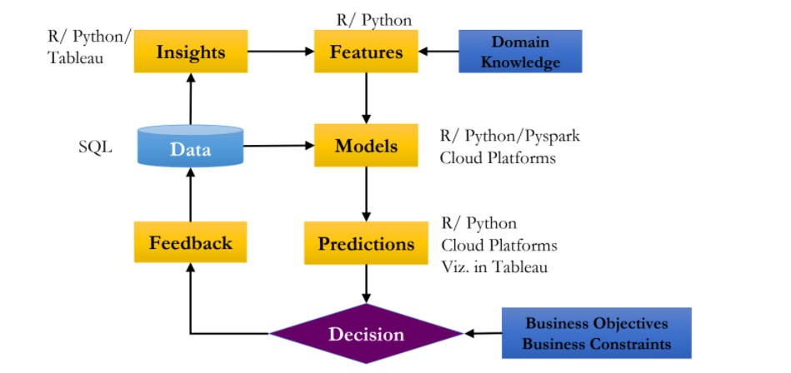
Project Architecture / Project Flow :

Slide 4
Exploratory Data Analysis (EDA) and Feature Engineering

Slide 5
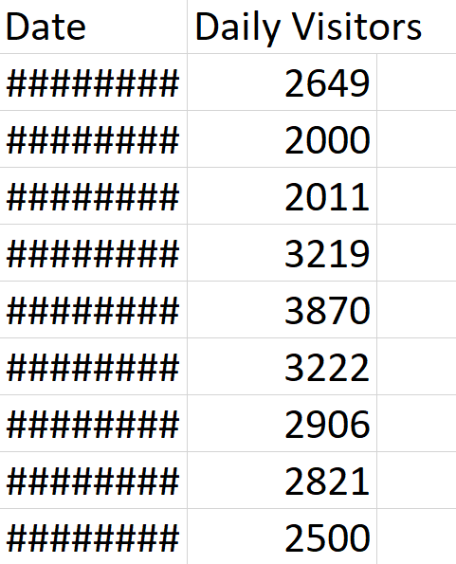
Dataset details :
The dataset is having 174 observations of 2 variables are as follows,
Date: the day of the month or year as specified by a number.
Daily Visitors: A person who frequents or visits a given place often.

Slide 6
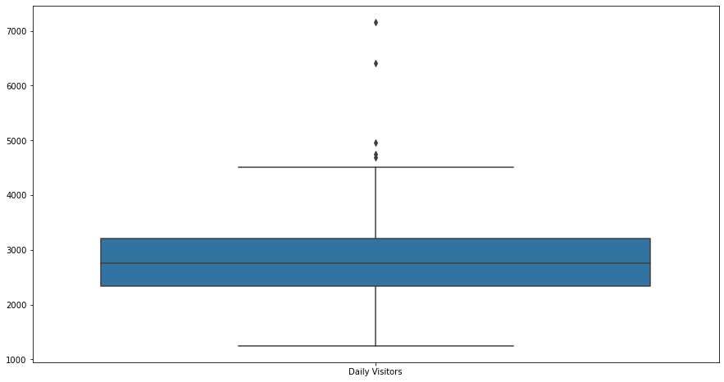
Checking Outliers by Box Plot :
Dataset has few outliers.
Dataset is Slightly positive Skewed.
A good measure for the most likely number of Daily Visitors is approximately 2,750.
Almost every visitor in internet is facing web traffic issue.

Slide 7
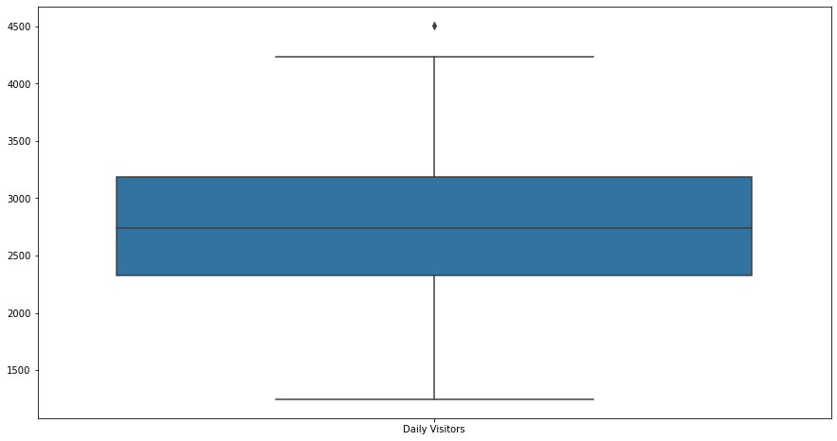
Outliers Detection by Box Plot:
Dataset has one outlier, which is negligible .
Dataset is normally Distributed.
A good measure for the most likely number of Daily Visitors is approximately 2,500.
Almost every visitor in internet is facing web traffic issue.

Slide 8
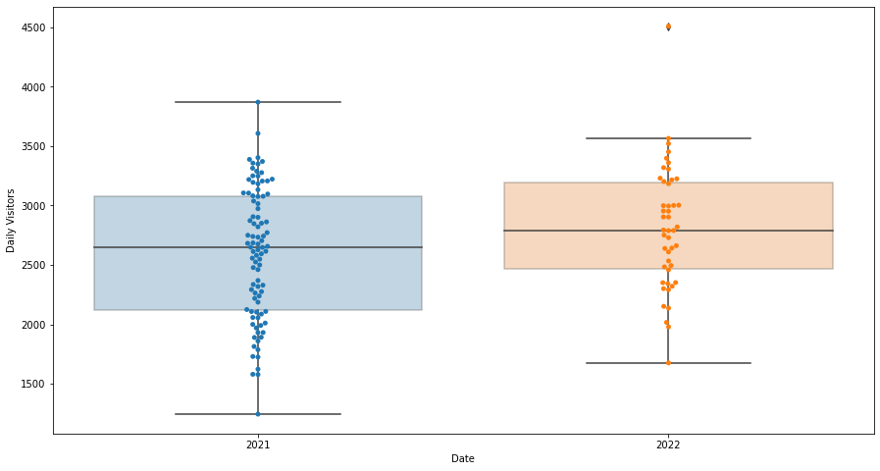
To see distribution of daily visitors in both years by Box Plot :
Daily visitors has gone down from 2021-2022 =>negative Trend present.

Slide 9
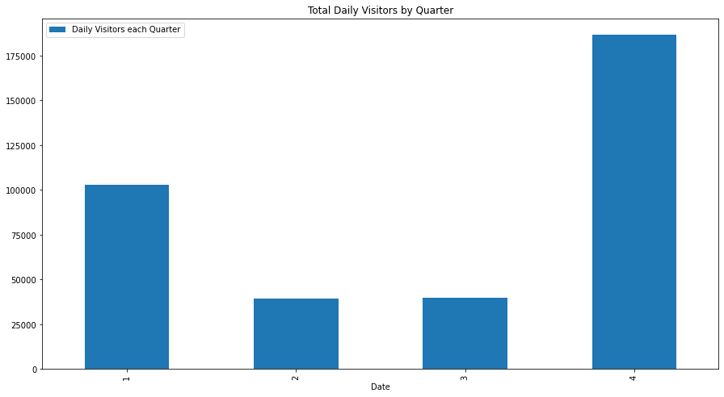
Total Daily Visitors by Quarter:
This will help us understand how much each quarter contributes relative to the average demand.

Slide 10
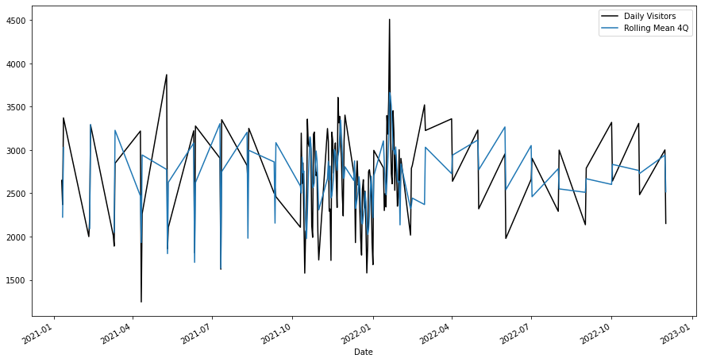
Auto Regressive Integrated Moving Average (ARIMA) :
ADFuller test on mean :
Notice that each year, there is no much more difference between the mean and the max. This can potentially mean additive seasonality.

Slide 11
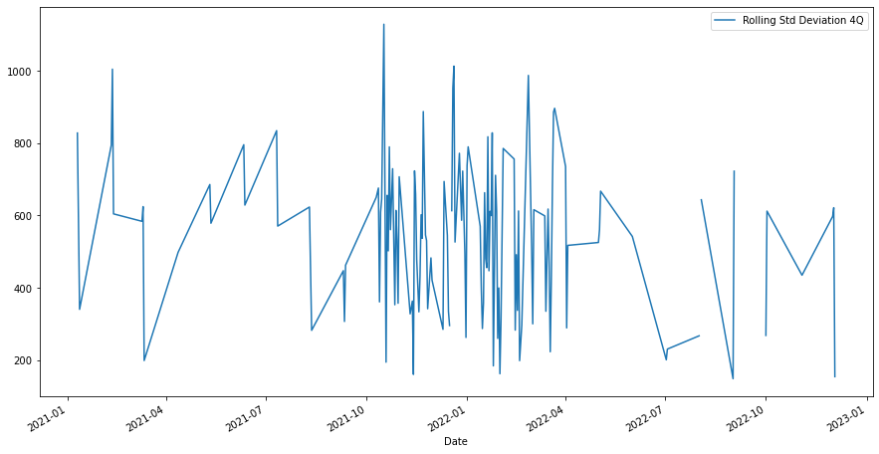
ADFuller test on standard deviation :
Both mean and standard deviation are increasing, thus not stationary.

Slide 12
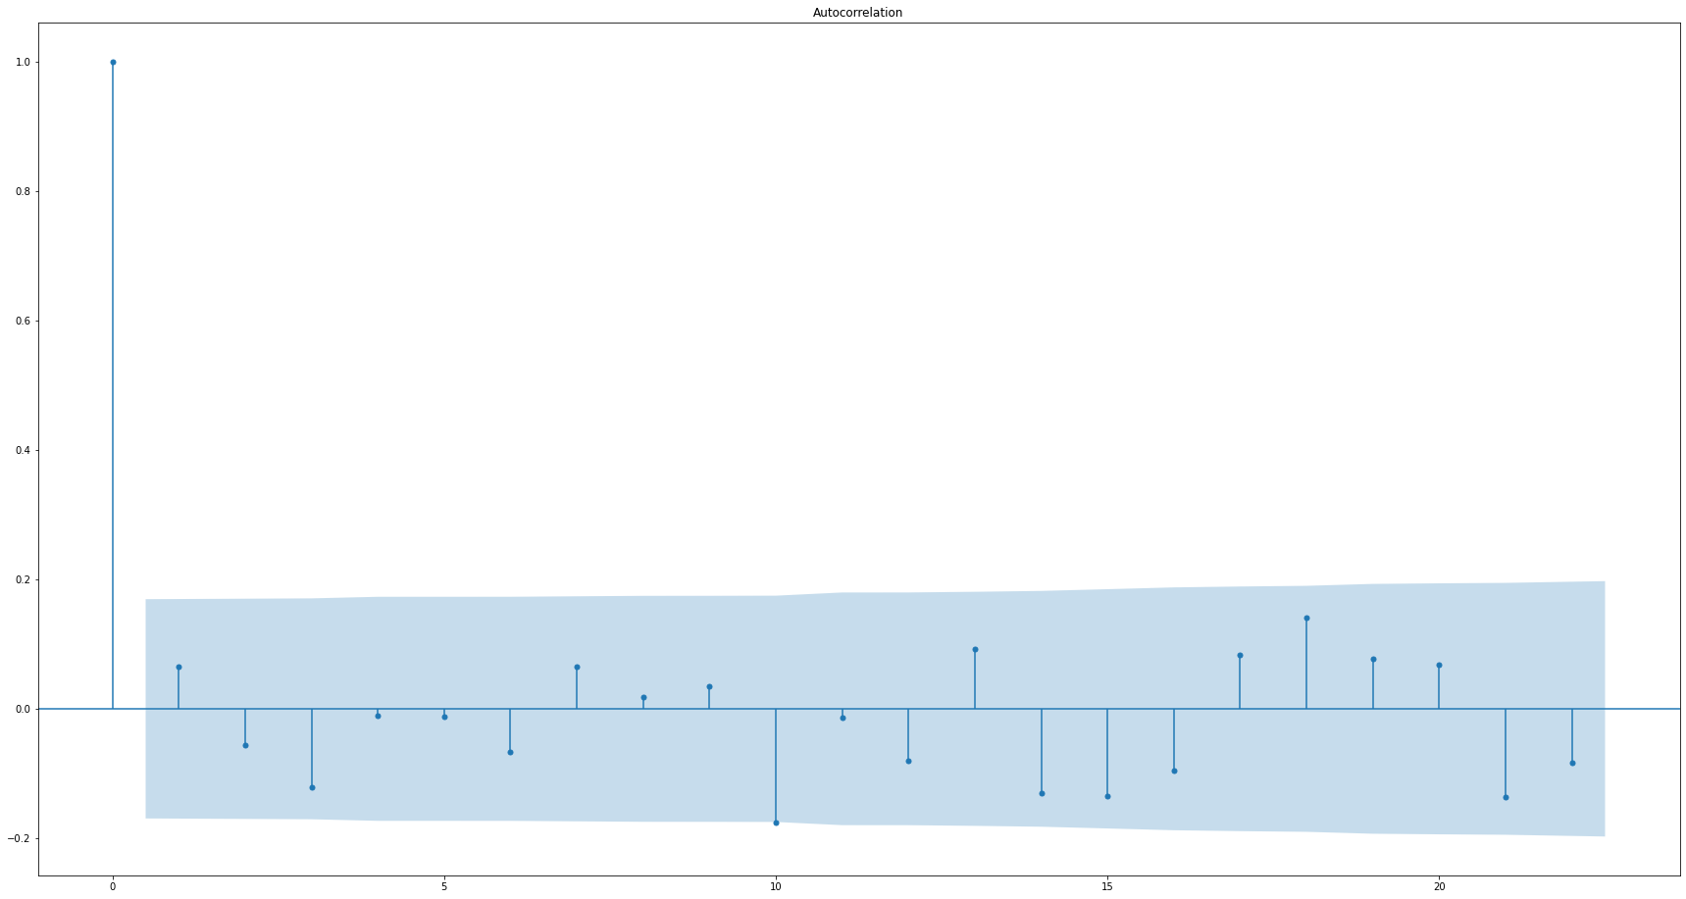
Autocorrelation:
ACF plot shows autocorrelation coeff is insignificant at all lag values

Slide 13
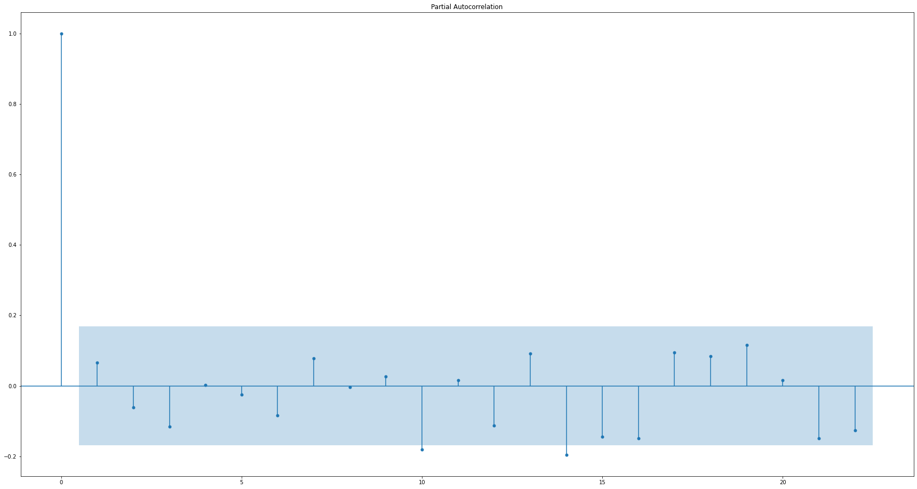
Partial Autocorrelation:
Partial autocorrelation, similar to partial correlation, shows correlation after 'partialing out' previous lags

Slide 14
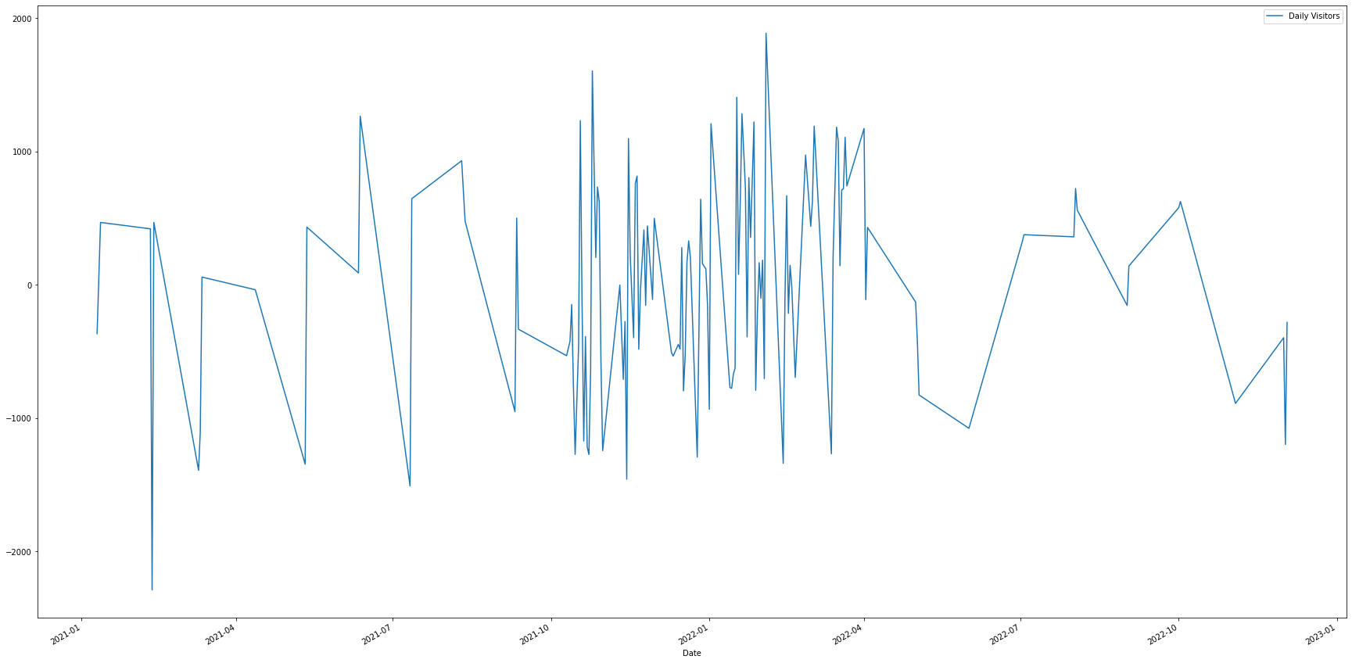
Adfuller statistic and De-trending:
By taking the first difference we de-trended the series and it has become stationary!

Slide 15
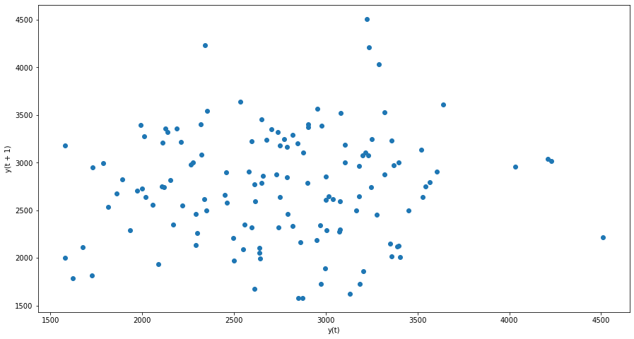
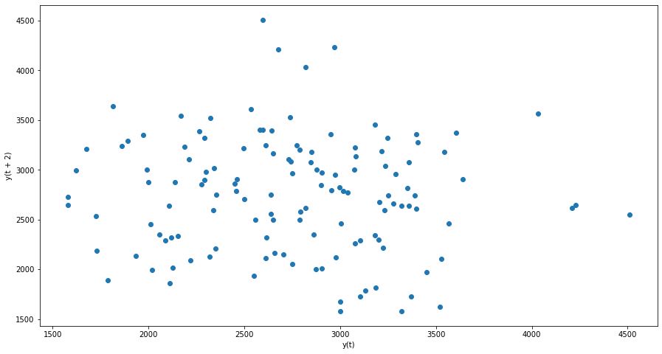
Lag plot -1:
Lag plot -2:

Slide 16
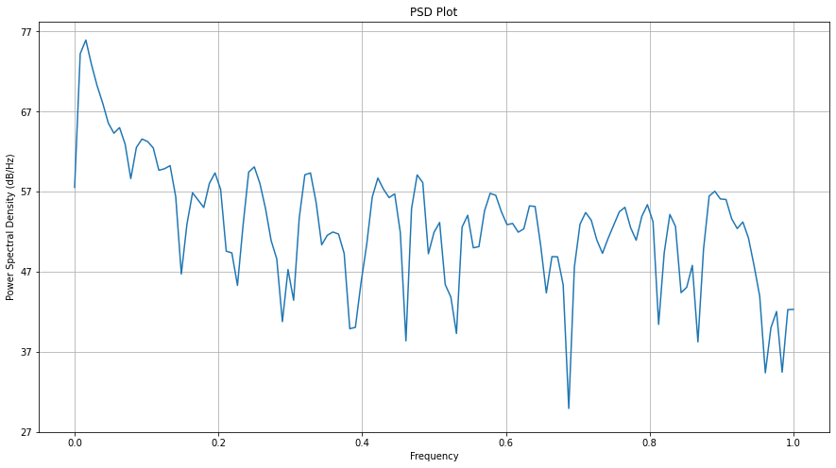
Power Spectral Density:
PSD shows the eaxct same information of the time series as the ACF

Slide 17
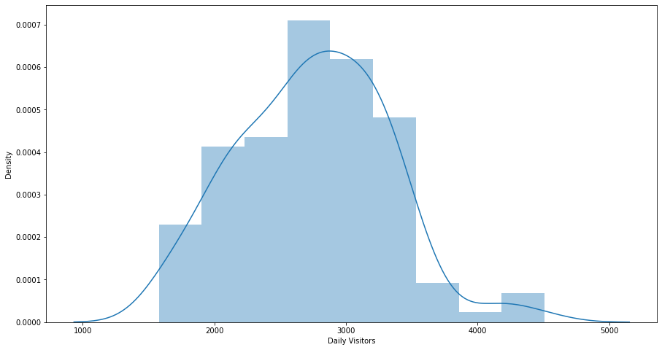
Distribution plot :
After using distplot and ‘Jarque Bera Stastical Test for Normality’ the series is converted in to normal

Slide 18
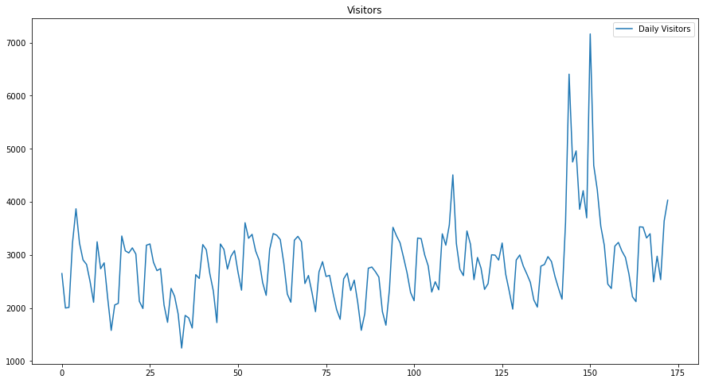
Holt Winter’s Exponential Smoothing (HWES):
Ordinary Plot Of Daily Visitors:
This will help us understand how Daily Visitors contribute relative to the average demand

Slide 19
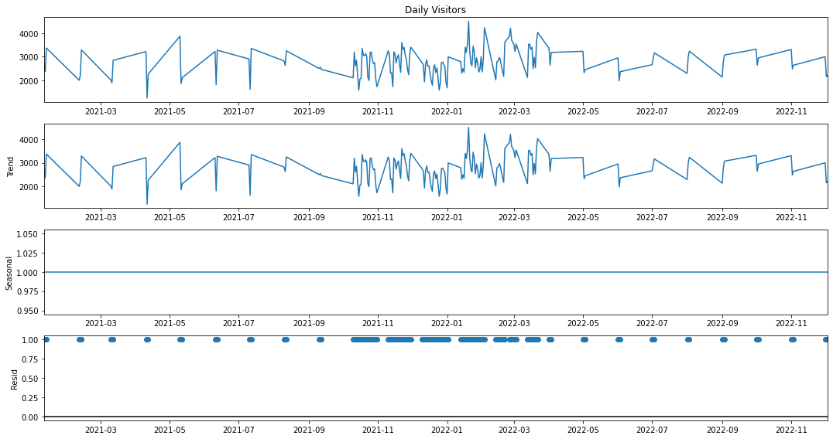
Decomposing the Time Series:
Now we will be decomposing the Time Series and will look for Levels, Trends and Seasonality in the data,
We can quite clearly see that the data has all 3, Levels, Trends, Seasonality.

Slide 20
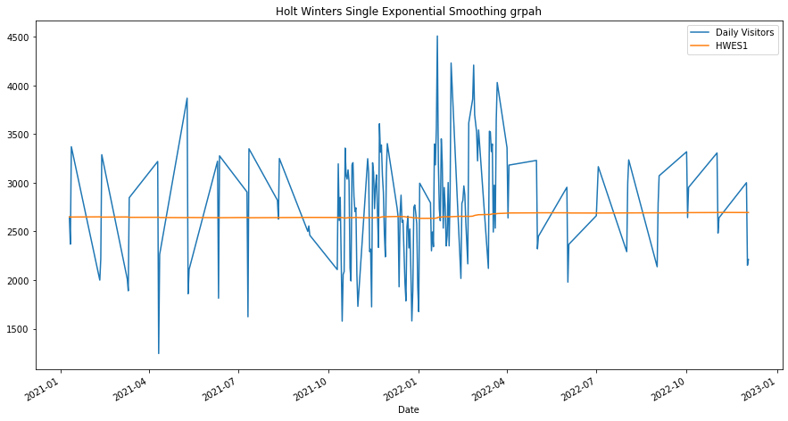
Single exponential smoothing of the visitors data set:
We fit the data on the Single Exponential Smoothing
it didn’t fit quite well, and rightfully so, because if we remember, Single ES doesn’t work for data with Trends and Seasonality.

Slide 21
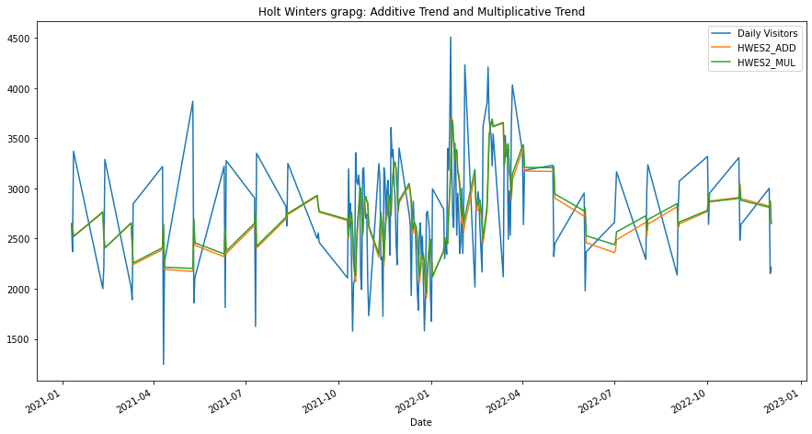
Double exponential smoothing of visitors data set ( Additive and multiplicative):
this looks a little better, but since we know there is no Seasonality,

Slide 22
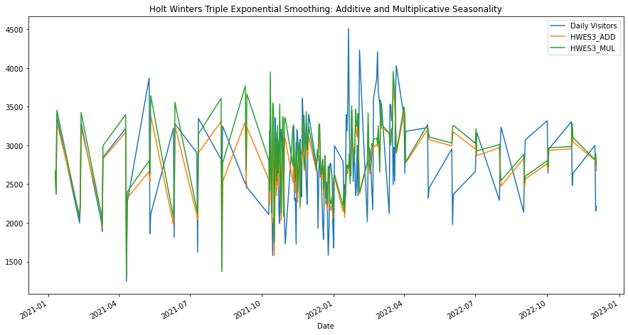
Train, Test and Predicted data points using Holt Winters Exponential Smoothing:
it seems that the model has done a decent job overall.

Slide 23
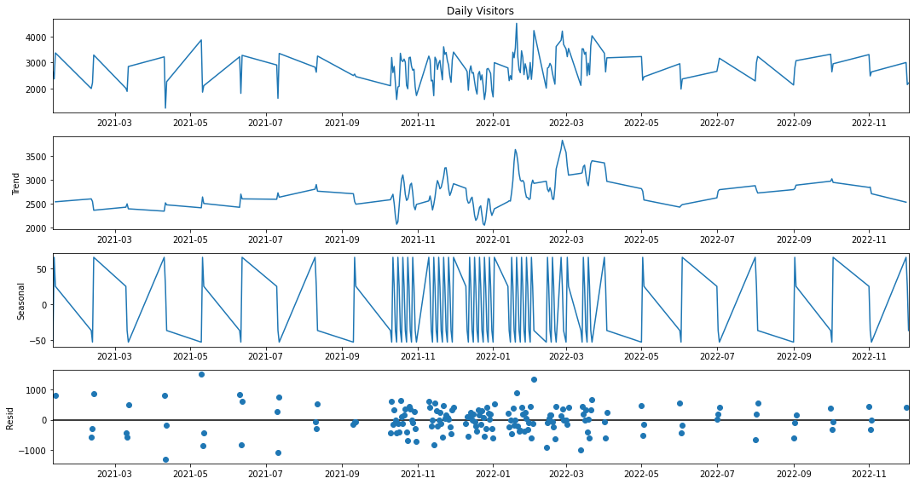
Moving Average(MA):
Additive model decomposition:
The decomposition, and plots the 4 resulting series. We observe that the Damped trend and Non-seasonality.

Slide 24
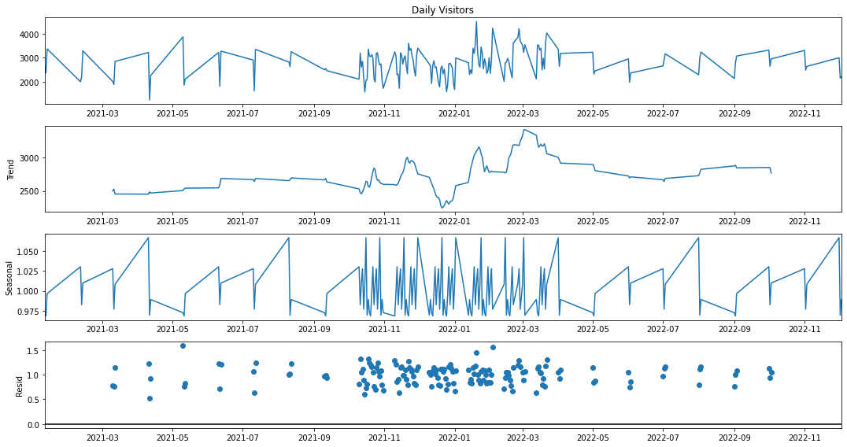
Multiplicative model decomposition:
The decomposition, and plots the 4 resulting series. We observe that the Damped trend and Non-seasonality.

Slide 25
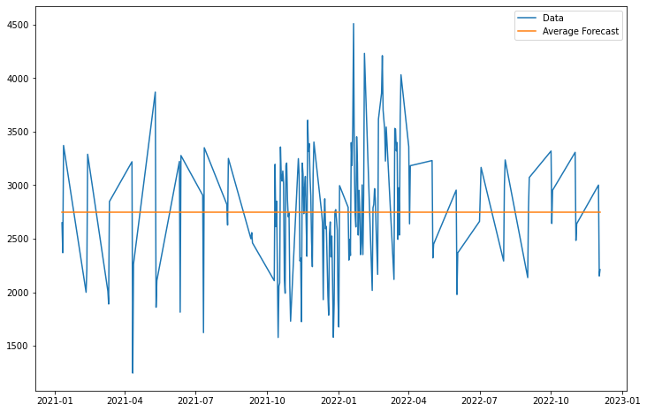
Mean Average forecasting:
We fit the data on the Mean Average.
It didn’t fit quite well, and rightfully so, because if we remember, Mean Average. doesn’t work for data with Trends and Seasonality.

Slide 26
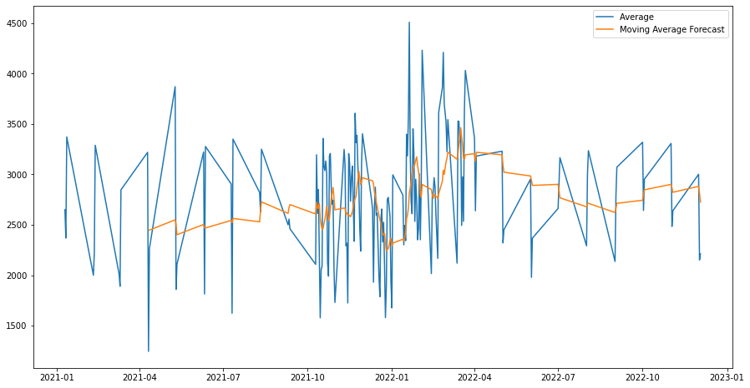
Moving average forcasting:
We fit the data on the Moving average .
It fit quite so, because Mean Average does work for data with Trends and Seasonality.

Slide 27
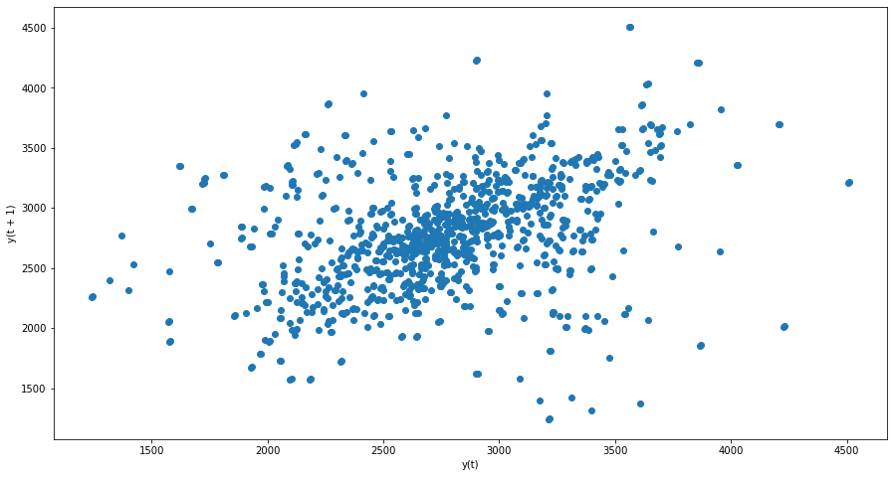
Auto Regression (AR):
Quick Check for Autocorrelation:
The Visitors data (t) on the x-axis against the visitors on the previous day (t-1) on the y-axis.

Slide 28
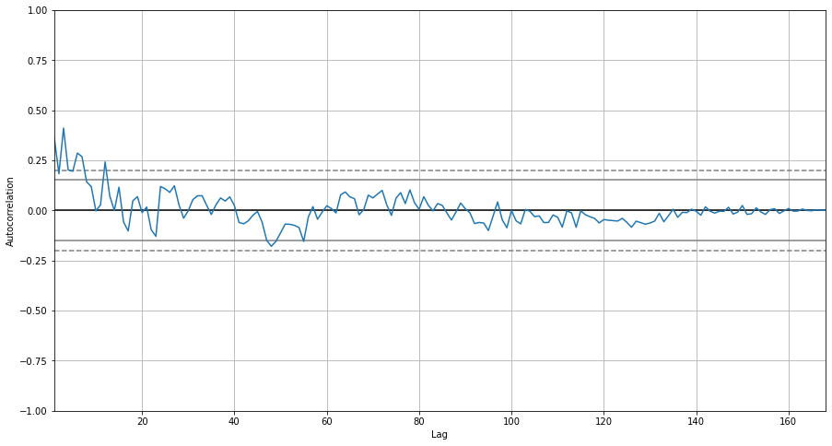
Autocorrelation:
The swing in positive and negative correlation as visitors change across each previous month.

Slide 29
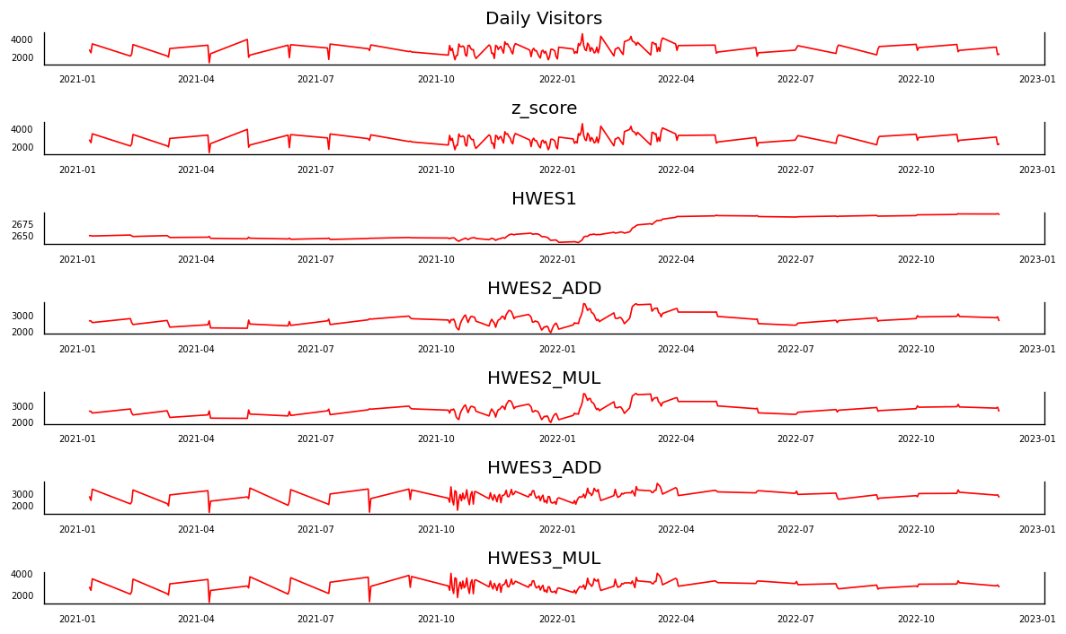
Vector Auto Regression:
Actual Multi Dimensional Time Series for VAR model:

Slide 30
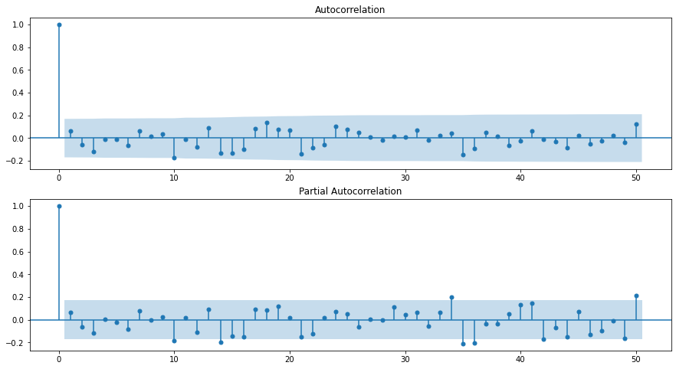
Seasonal Auto Regressive Integrated Moving Average (SARIMA):
Autocorrelation and Partial Autocorrelation:
:

Slide 31
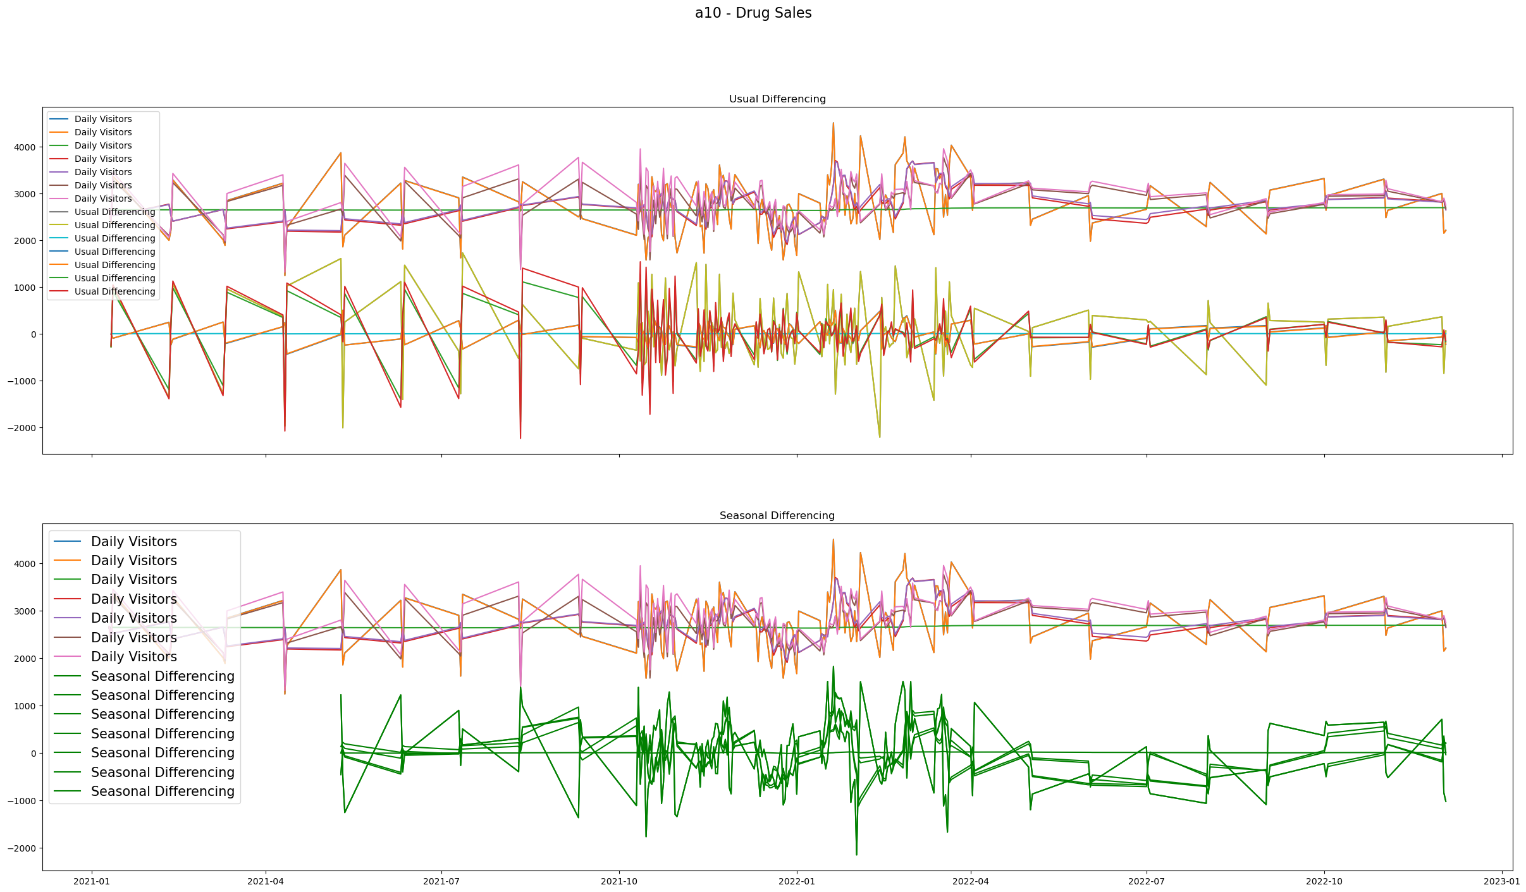
Seasonal Differencing:

Slide 32
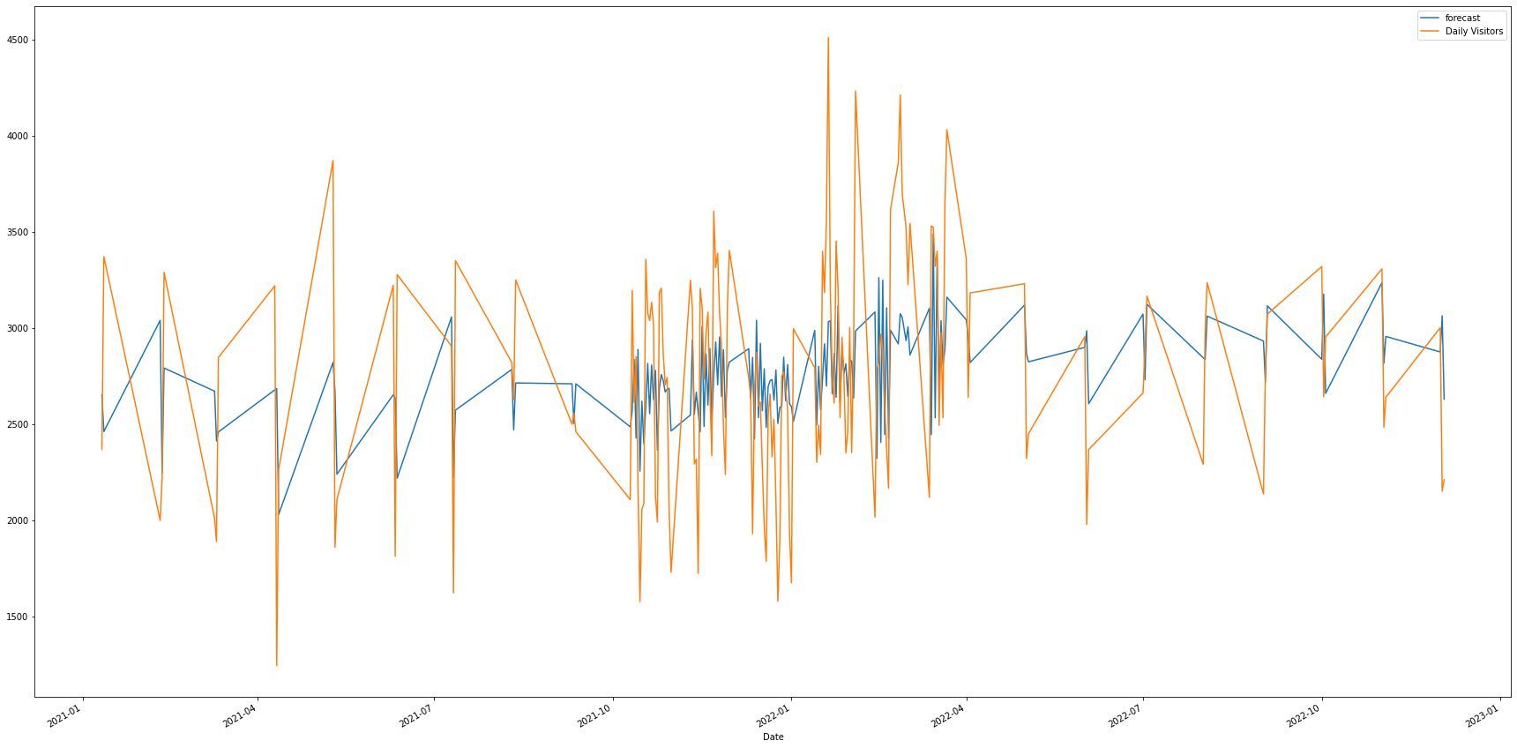
Actual vs Fitted:

Slide 33
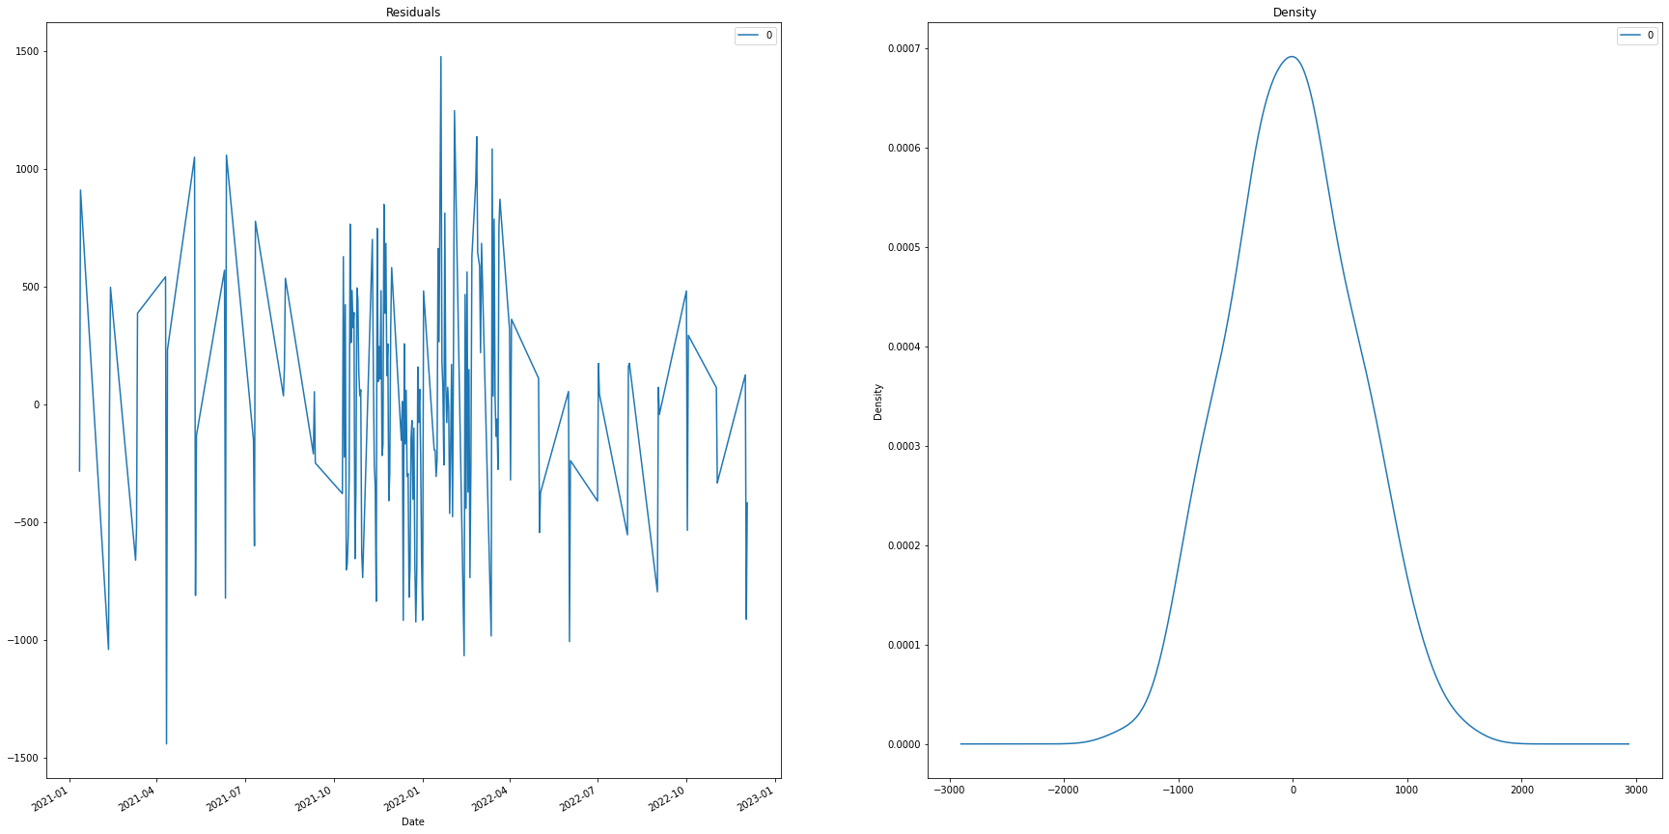
Residual and density plots:

Slide 34
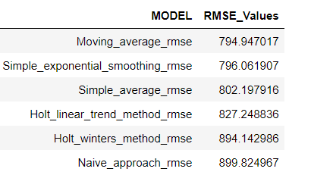
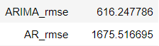
Model Summary:
In this prediction ARIMA has low rmse. Therefore, this model is Selected for deployment to prediction.

Slide 35
Model Deployment

Slide 36
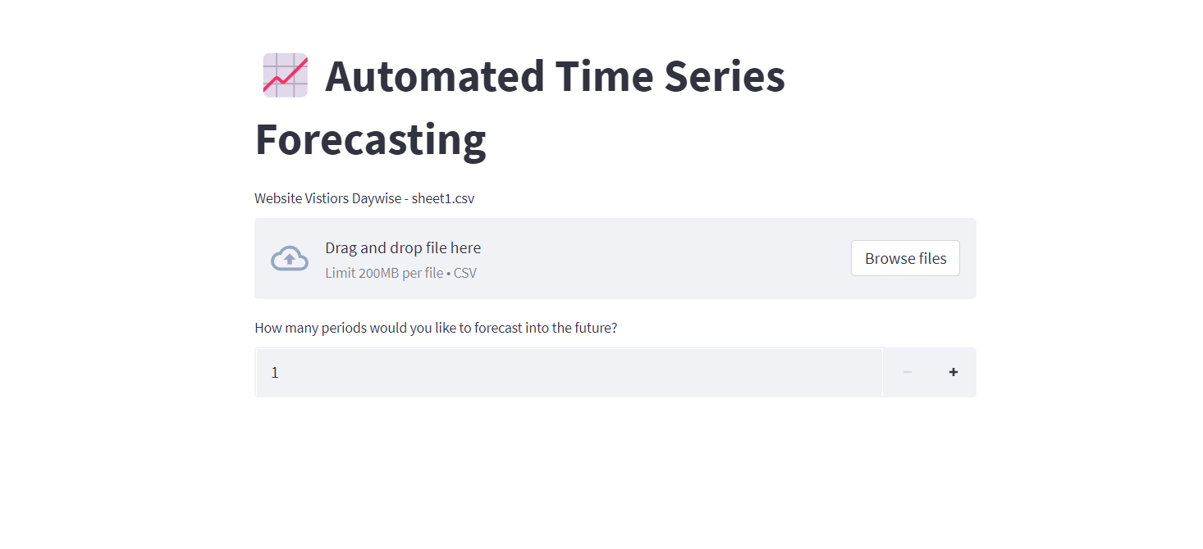
Using streamlit:

Slide 37
Challenges faced?
Understanding of data set due to time series.
Detecting outlier.
How did you overcome?
Gained domain knowledge with domain experts.
Done EDA phase to detecting outliers.

Slide 38
THANK YOU

